Slide 1
Chapter 6: Behavioral Modeling

Slide 2
Learning Objectives
Understand the rules and style guidelines for sequence diagrams.

Slide 3
Introduction
Behavioral models describe the internal behavior of a system
Behavioral model types:
Representations of the details of a business process identified by use-cases
Interaction diagrams (Sequence & Communication)
Types
Sequence Diagrams—emphasize message sequence
Communication Diagrams—emphasize message flow
Focus (for now) is on the dynamic view of the system, not on how it is implemented

Slide 4
Interaction Diagrams
Objects—an instantiation of a class
Patient is a class
Mary Wilson is an instantiation of the patient class (object)
Attributes—characteristics of a class
Patient class: name, address, phone, etc.
Operations—the behaviors of a class, or an action that an object can perform
Messages—information sent to objects to tell them to execute one of their behaviors
A function call from one object to another

Slide 5
Sequence Diagrams
Illustrate the objects that participate in a single use-case
A dynamic model
Shows the sequence of messages that pass between objects
Aid in understanding real-time specifications and complex use-cases
Generic diagram shows all scenarios for a use-case
Instance diagrams show a single scenario

Slide 6
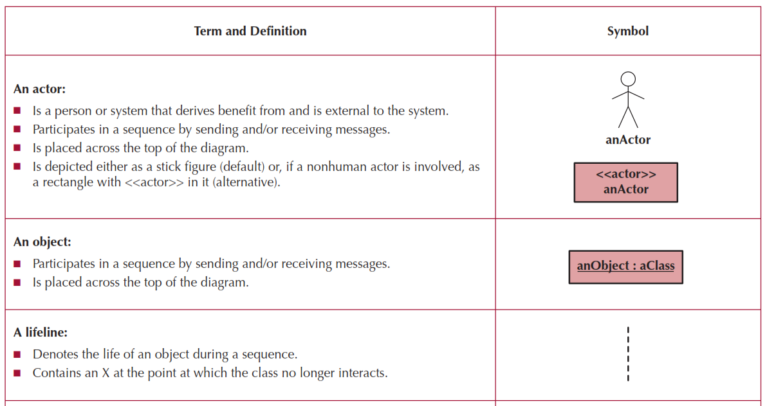
Sequence Diagram Syntax

Slide 7
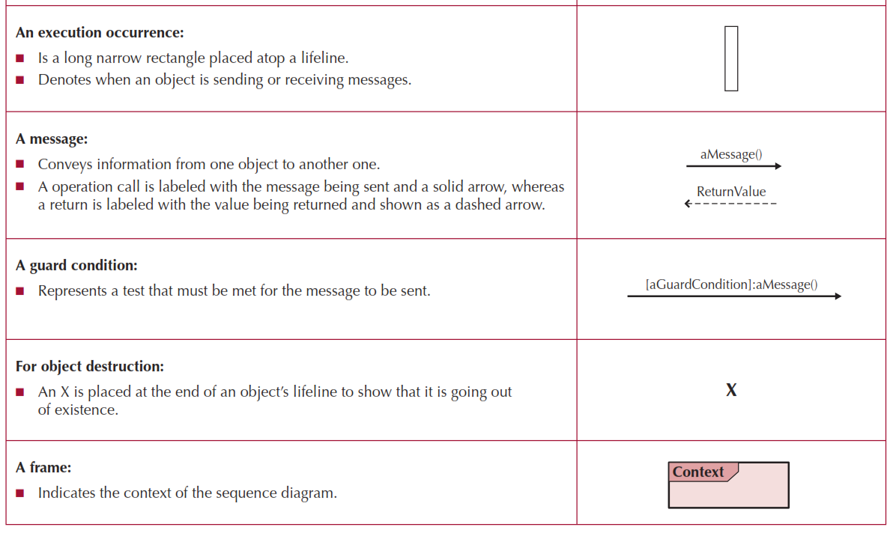
More Sequence Diagram Syntax

Slide 8
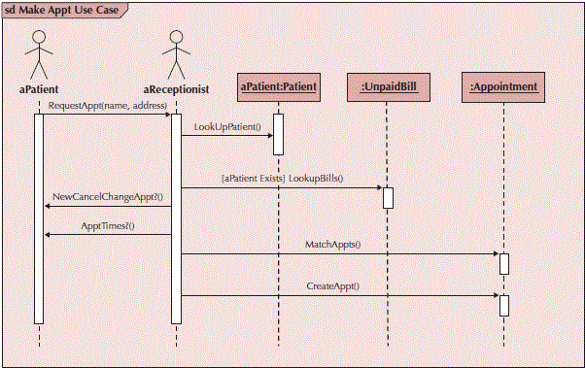
Sample Sequence Diagram

Slide 9
Building Sequence Diagrams
Set the context
Identify actors and objects that interact in the use-case scenario
Set the lifeline for each object
Add messages by drawing arrows
Shows how they are passed from one object to another
Include any parameters in parentheses
Obvious return values are excluded
Add execution occurrence to each object’s lifeline
Validate the sequence diagram
Ensures that it depicts all of the steps in the process

Slide 10
Summary
Behavioral Models—provide a detailed view of how object collaborations support use-cases
Interaction Diagrams
Sequence diagrams

